Slide 1
Group 8
IMDCGD111-16YRD
Joseph Barber, Elliot Dewhurst, John Dorman, Miruna Rosca

Slide 2
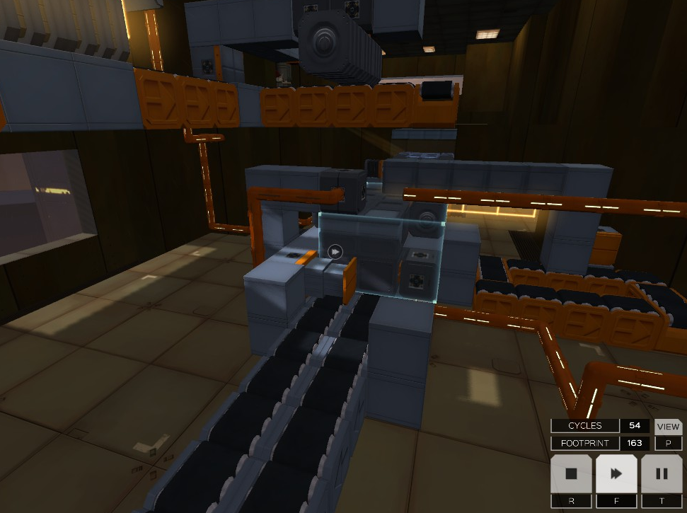
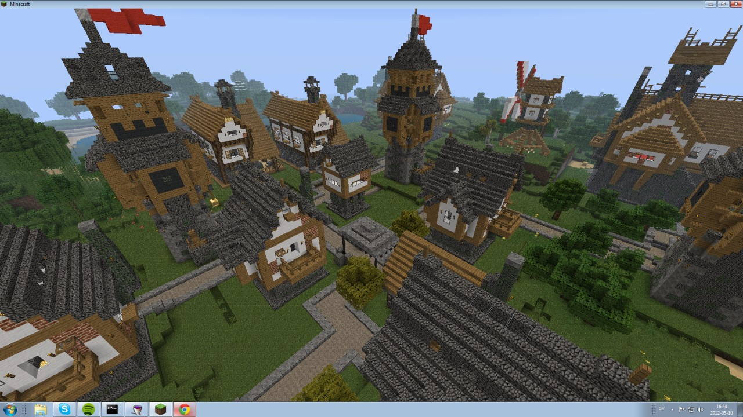
Brief Overview
Brief:
Exploring emergent gameplay with a focus on puzzle based games.
Inventing a solution opposed to finding the solution

Slide 3
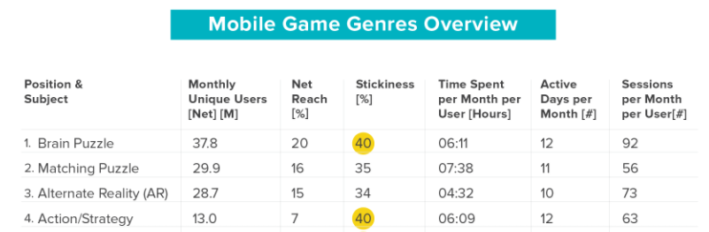
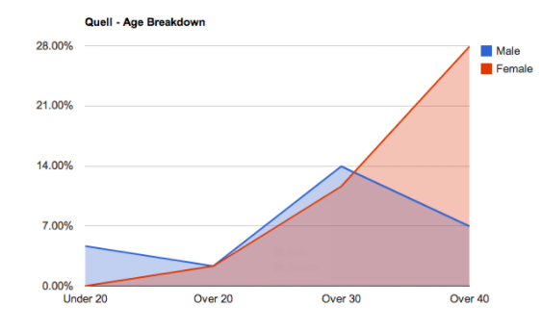
Brief Overview
Demographic:
Puzzle games are popular on mobile devices.
Logical puzzle games are popular amongst older males & females.
Android and iOS
20 to 40 year old, Males & Females
Verto Analytics. What are the most popular mobile game genres, and who's playing them?
Art and Theme in a Logical Puzzle Game - The Voxel Agents.

Slide 4
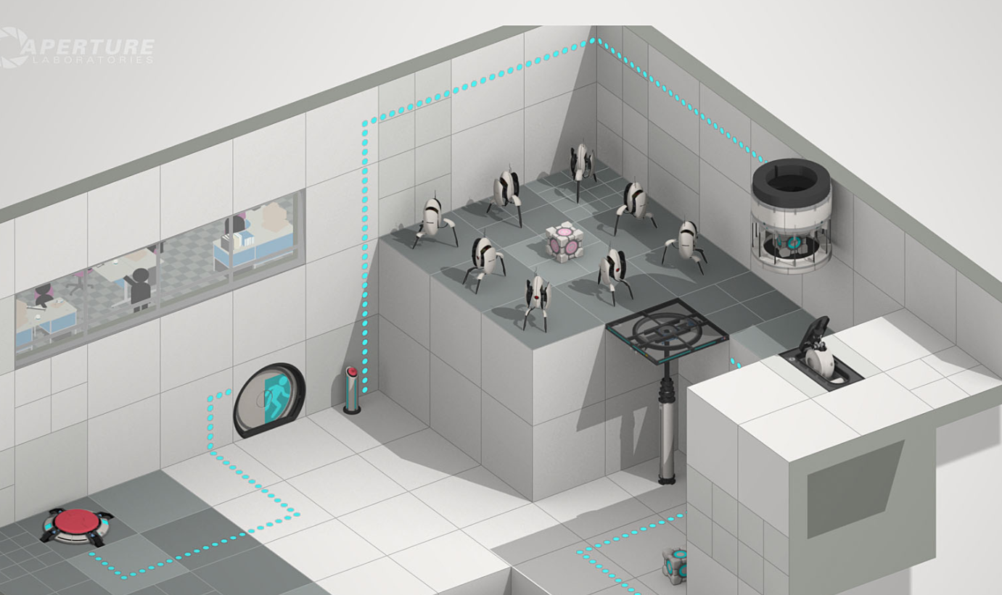
Concept 1 - Overview
Room Escape Game
Provided tools to the player to build a way to reach the level exit.
First person 3D
Android, iOS
Image reference
Official Portal 2 Website - Blog. 2017. Official Portal 2 Website - Blog. [ONLINE] Available at: http://www.thinkwithportals.com/blog.php. [Accessed 7 October 2017].

Slide 5
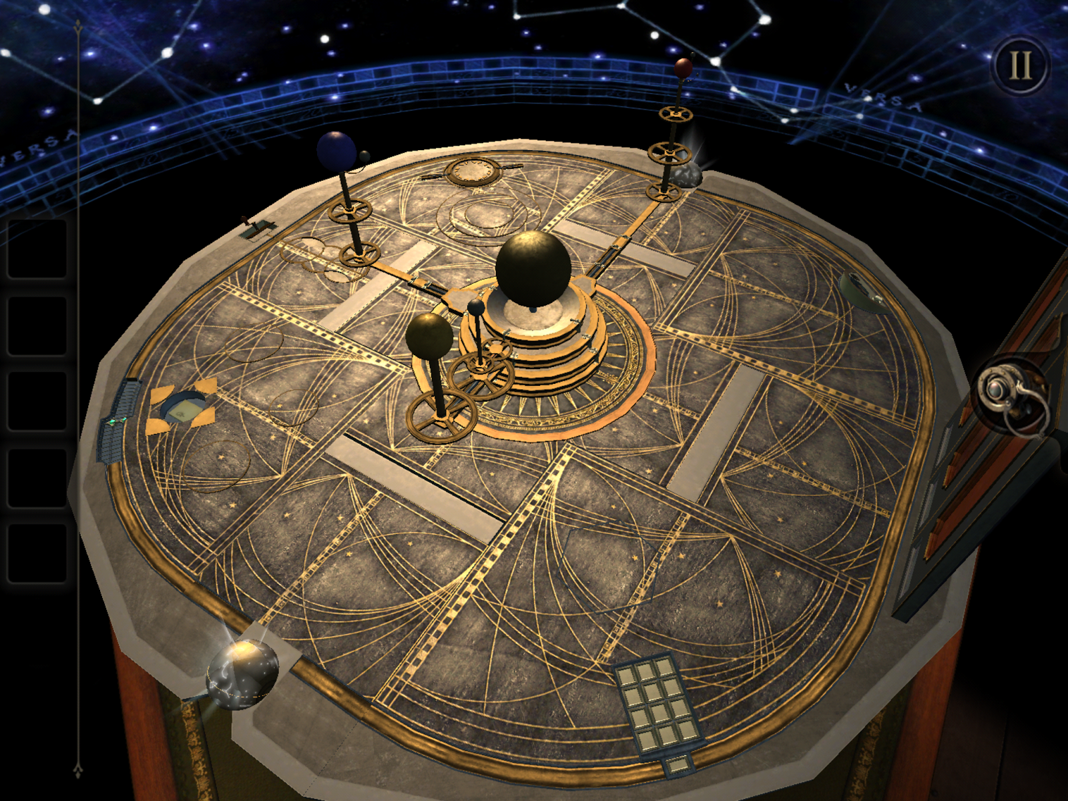
Concept 1 - Core Gameplay
Core game loop
Explore the level
Build your solution
Execute

Slide 6
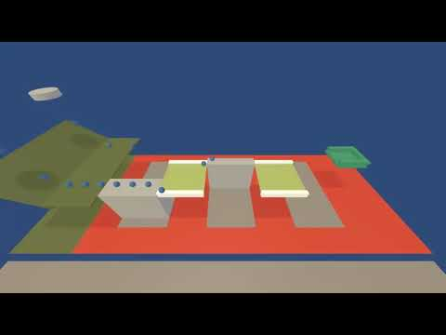
Concept 1 - Prototype

Slide 7

Concept 1 - Concept/Moodboards

Slide 8
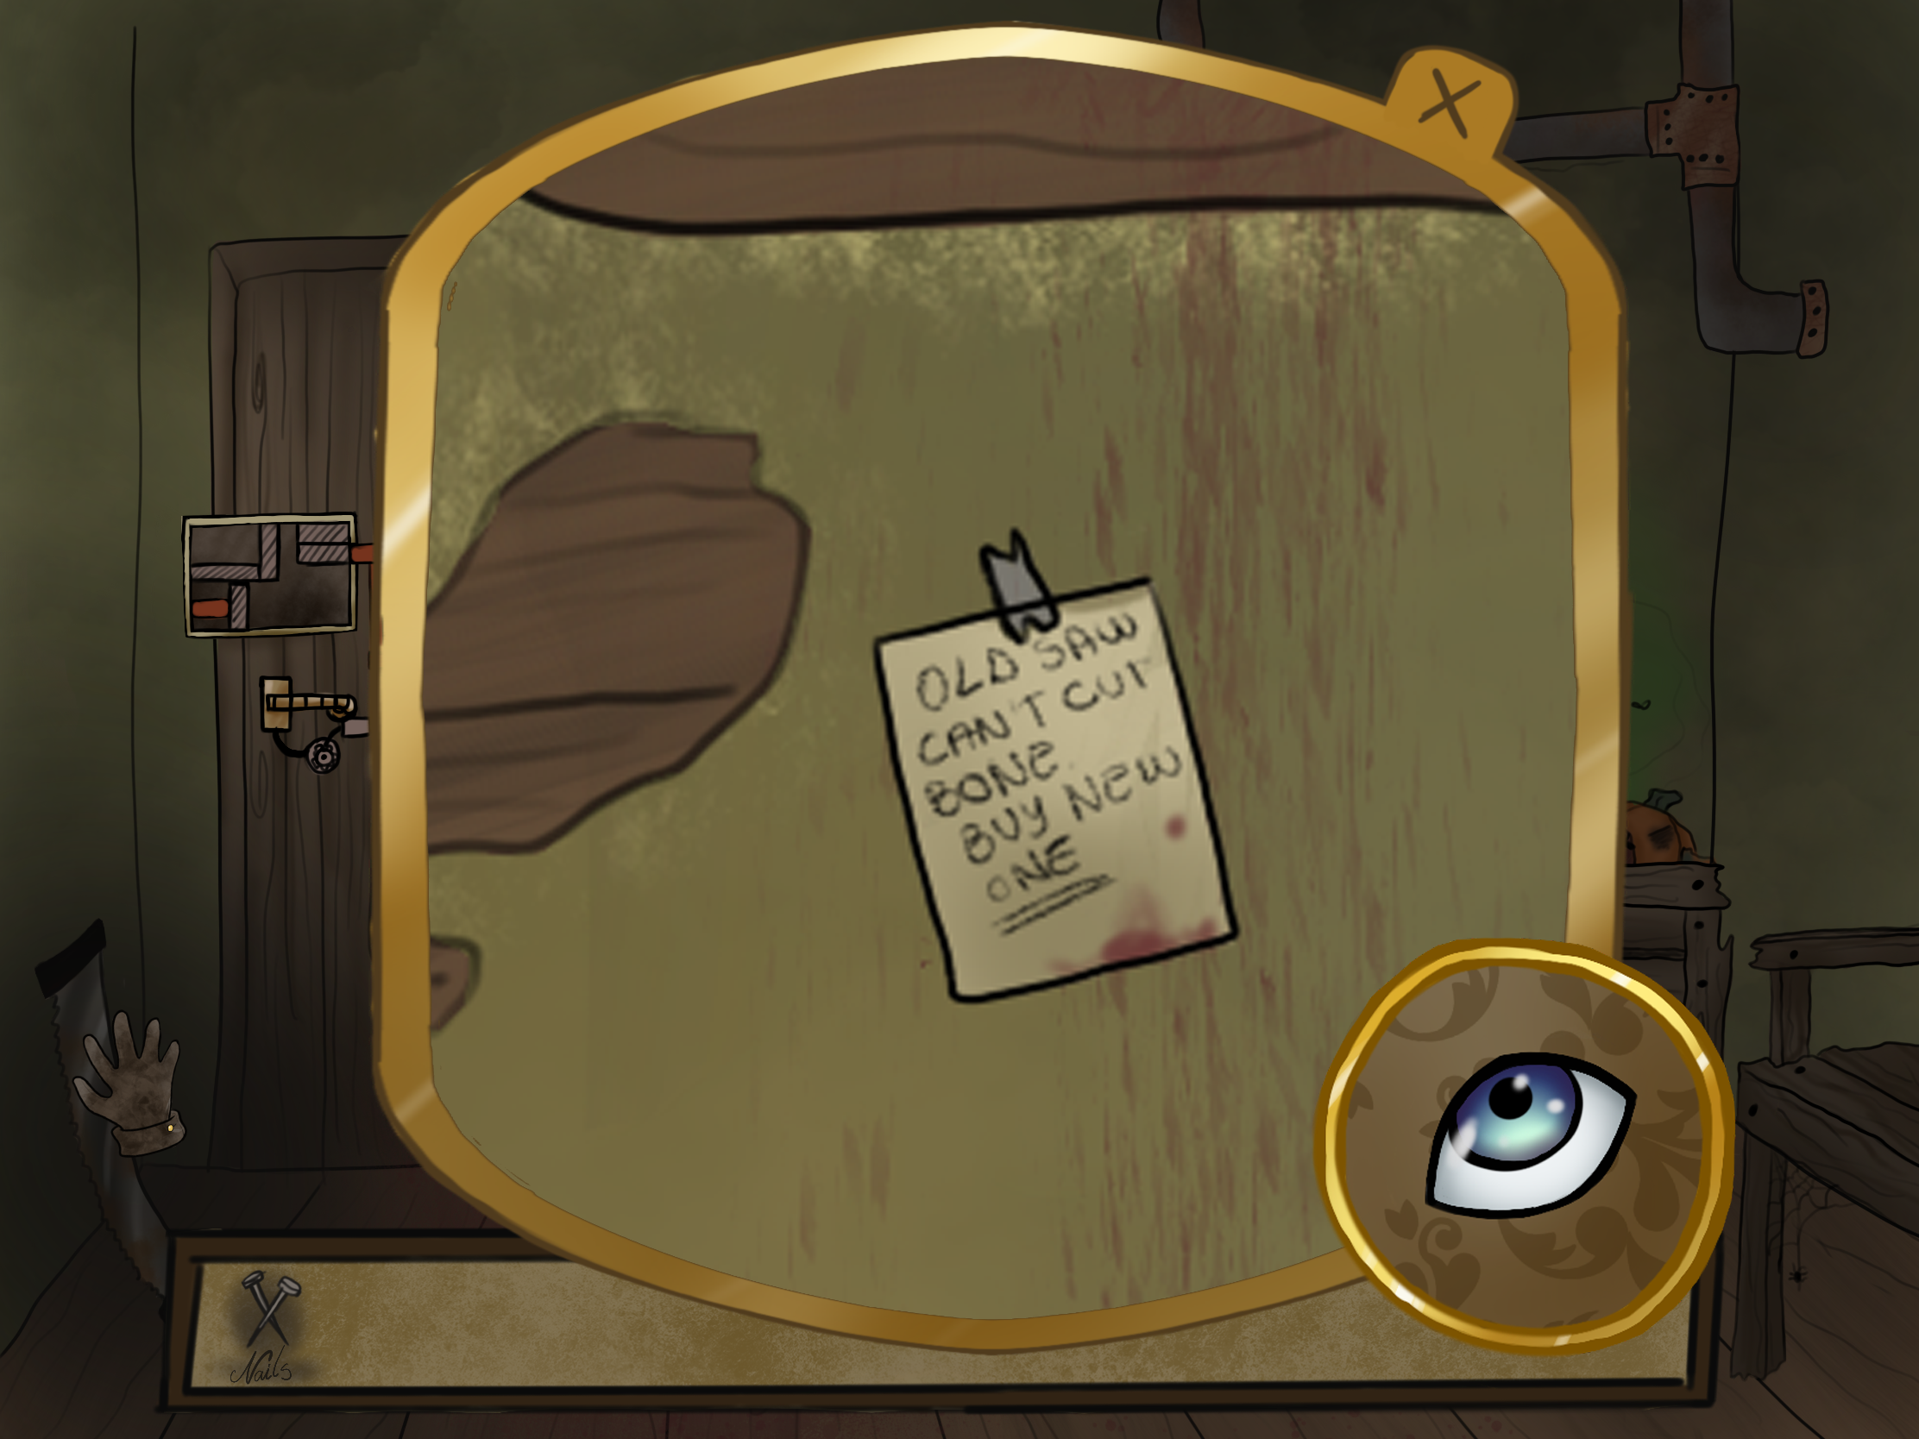
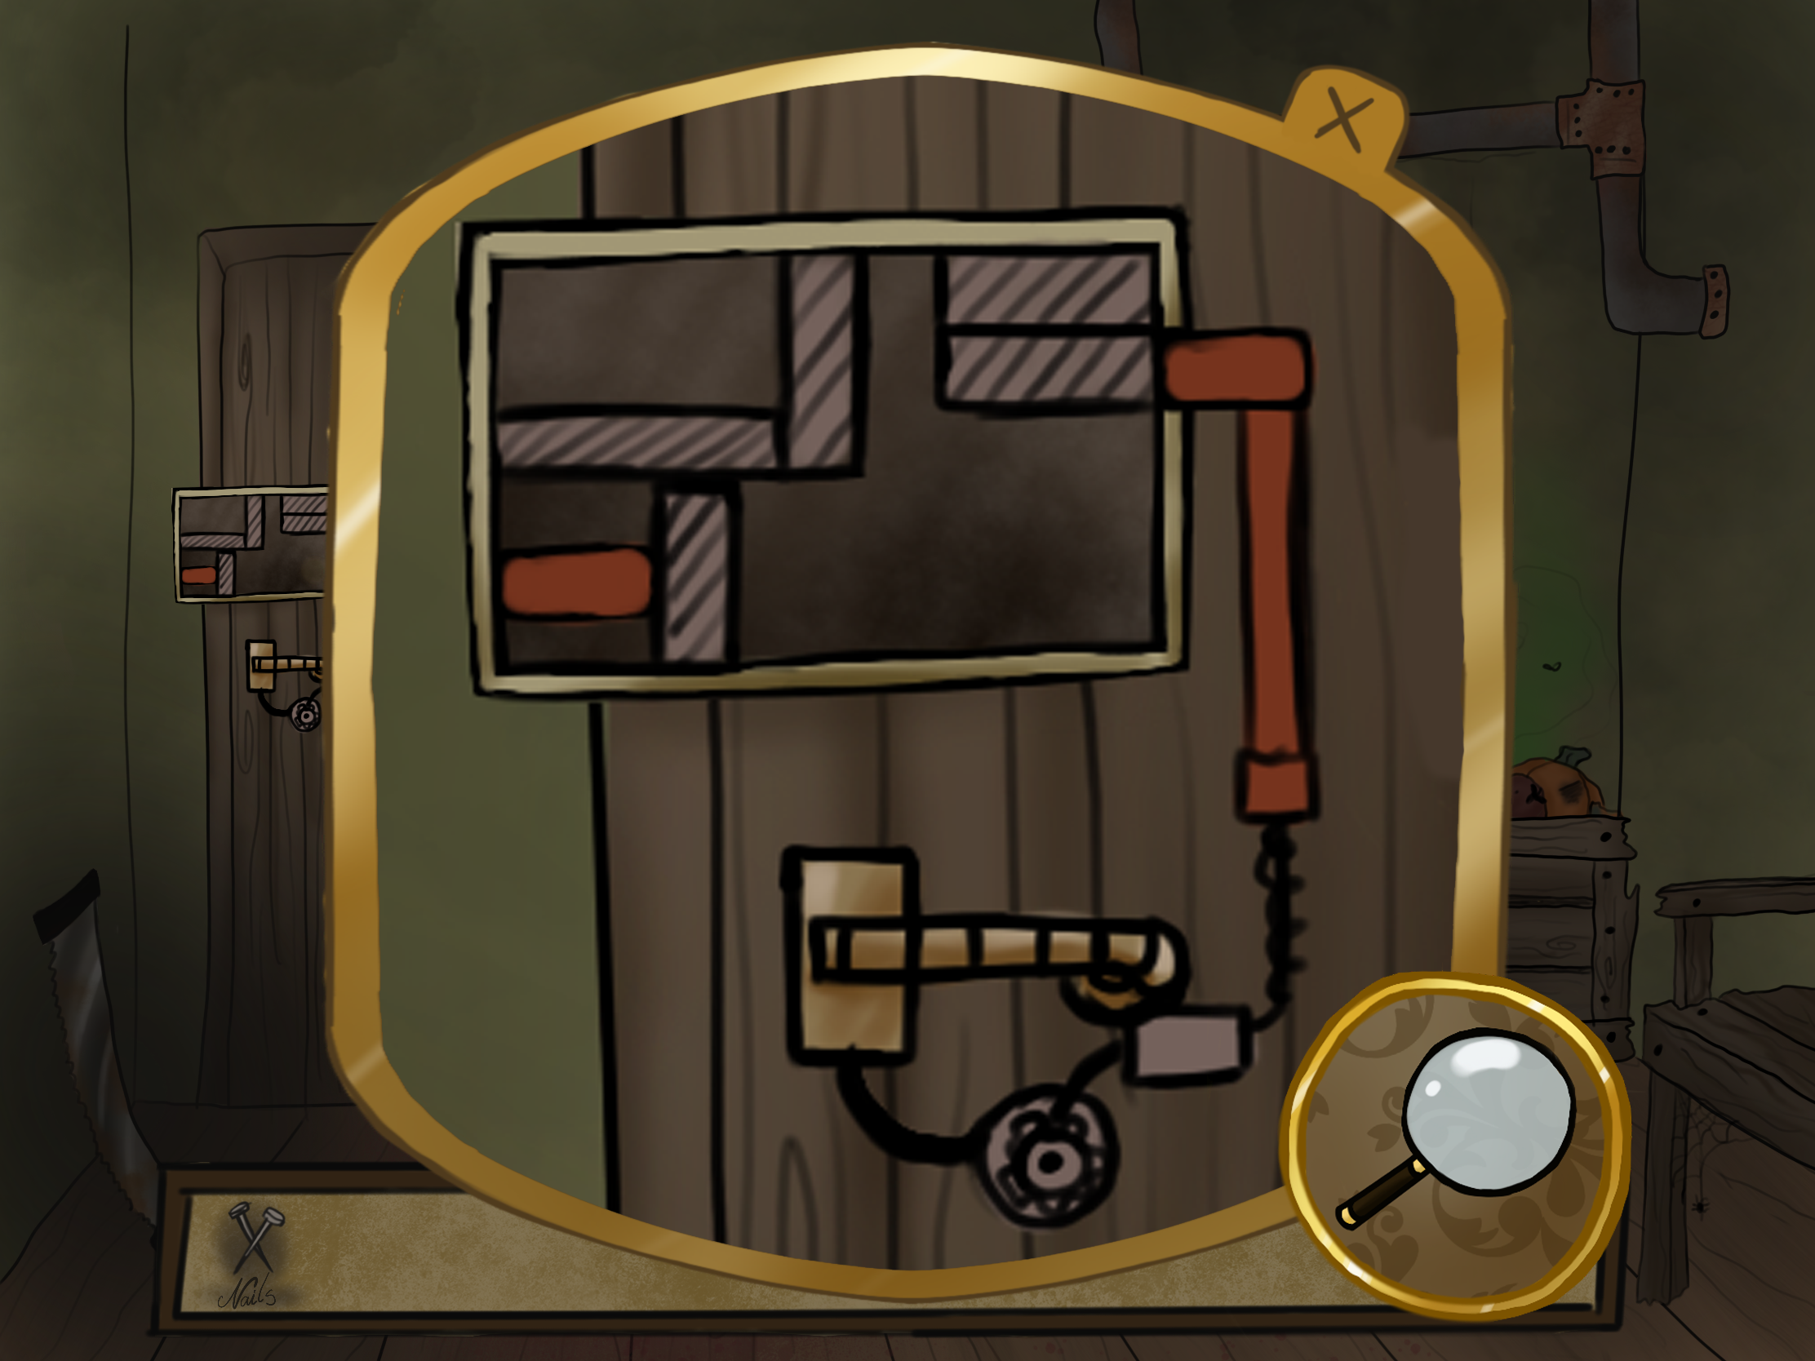
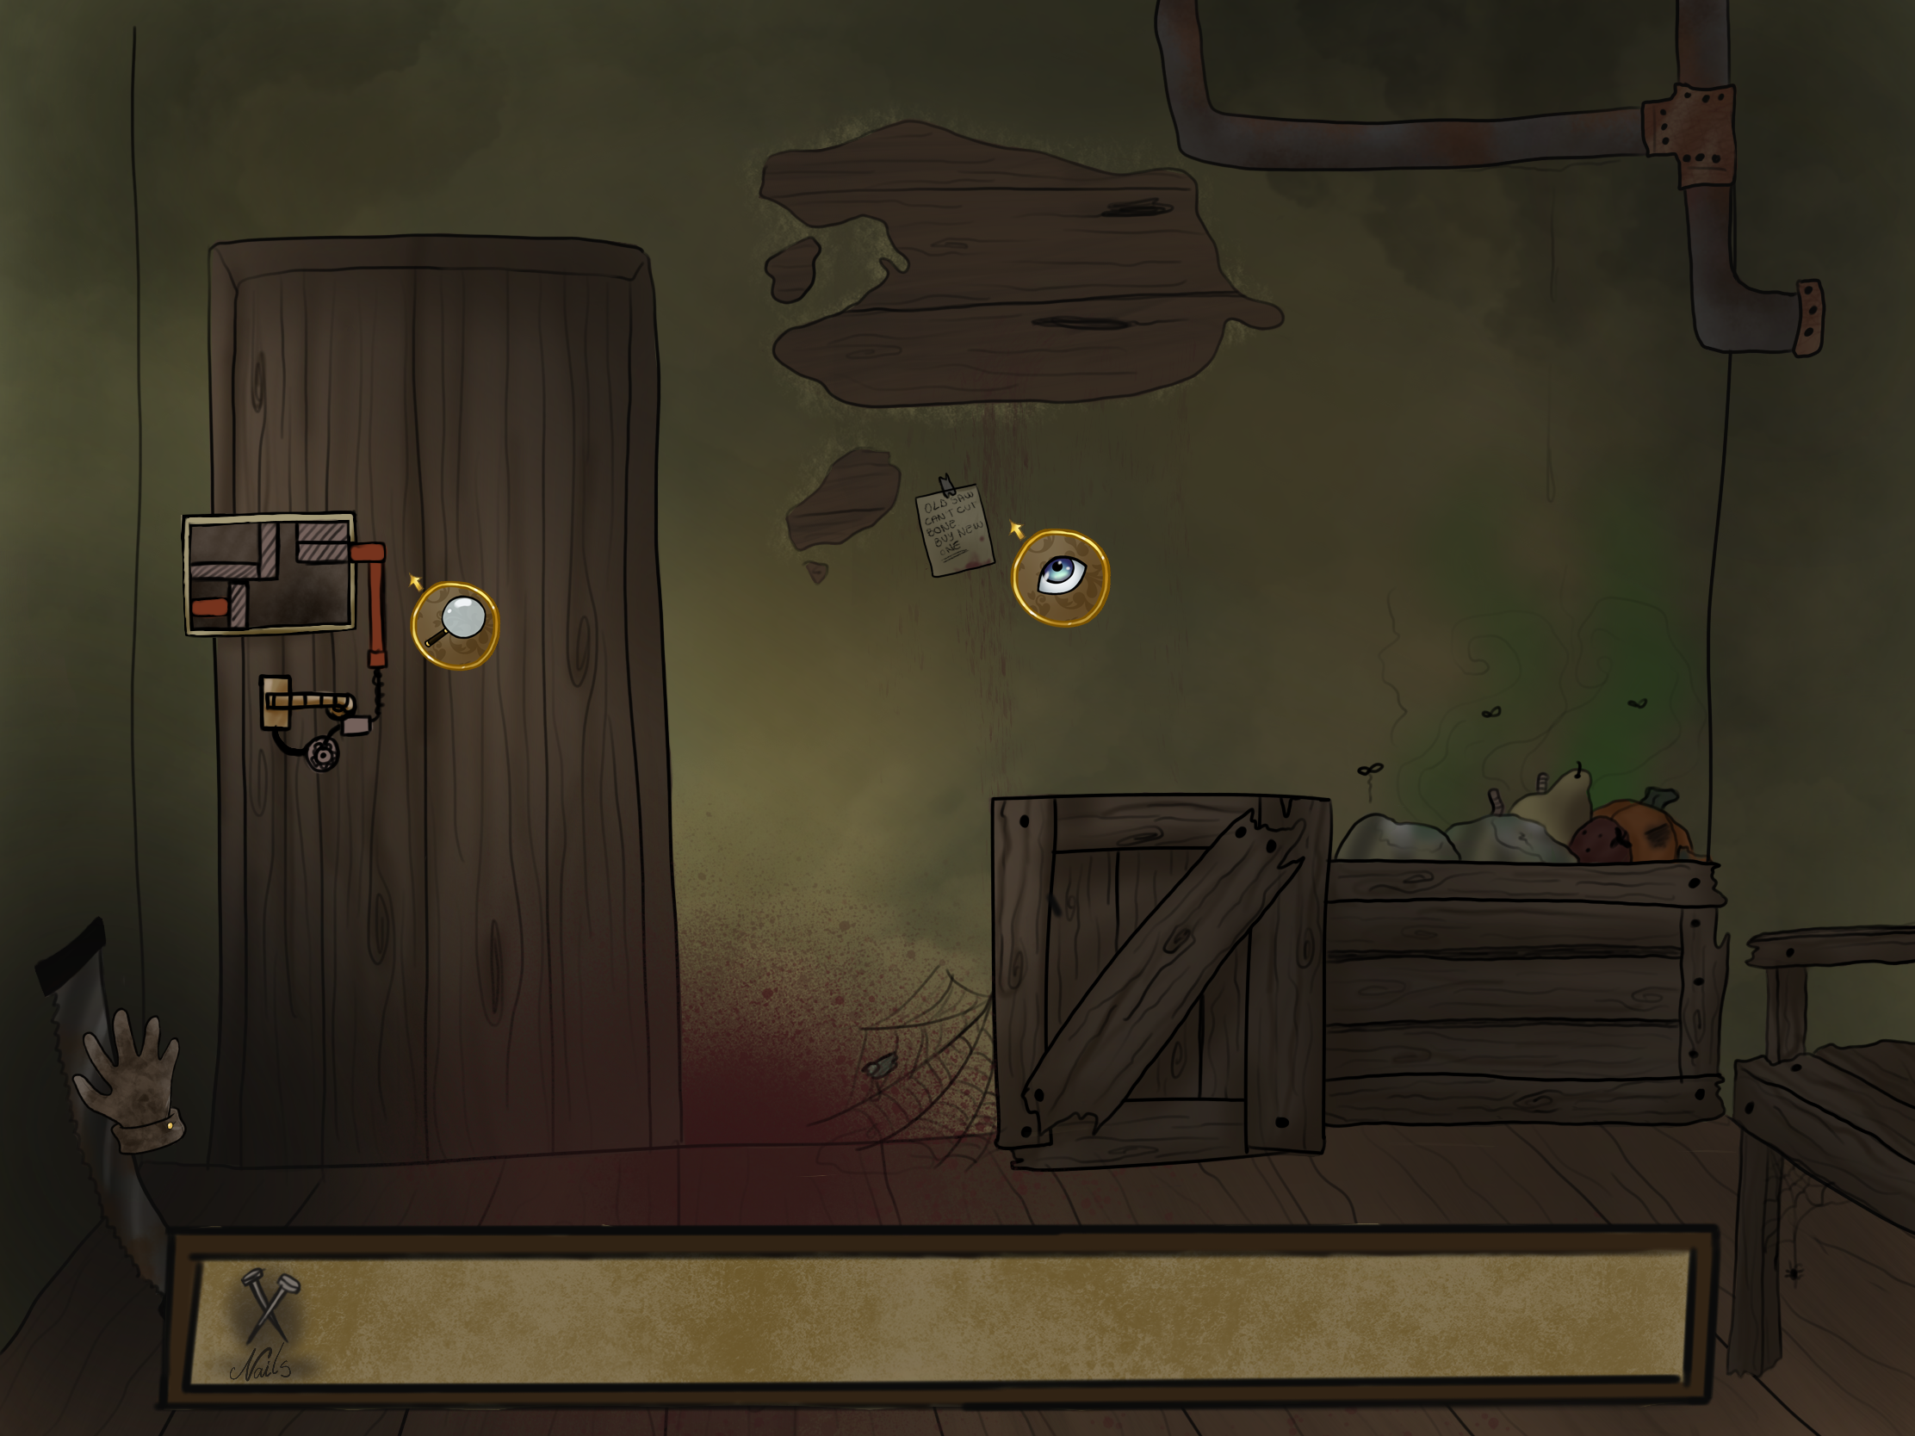
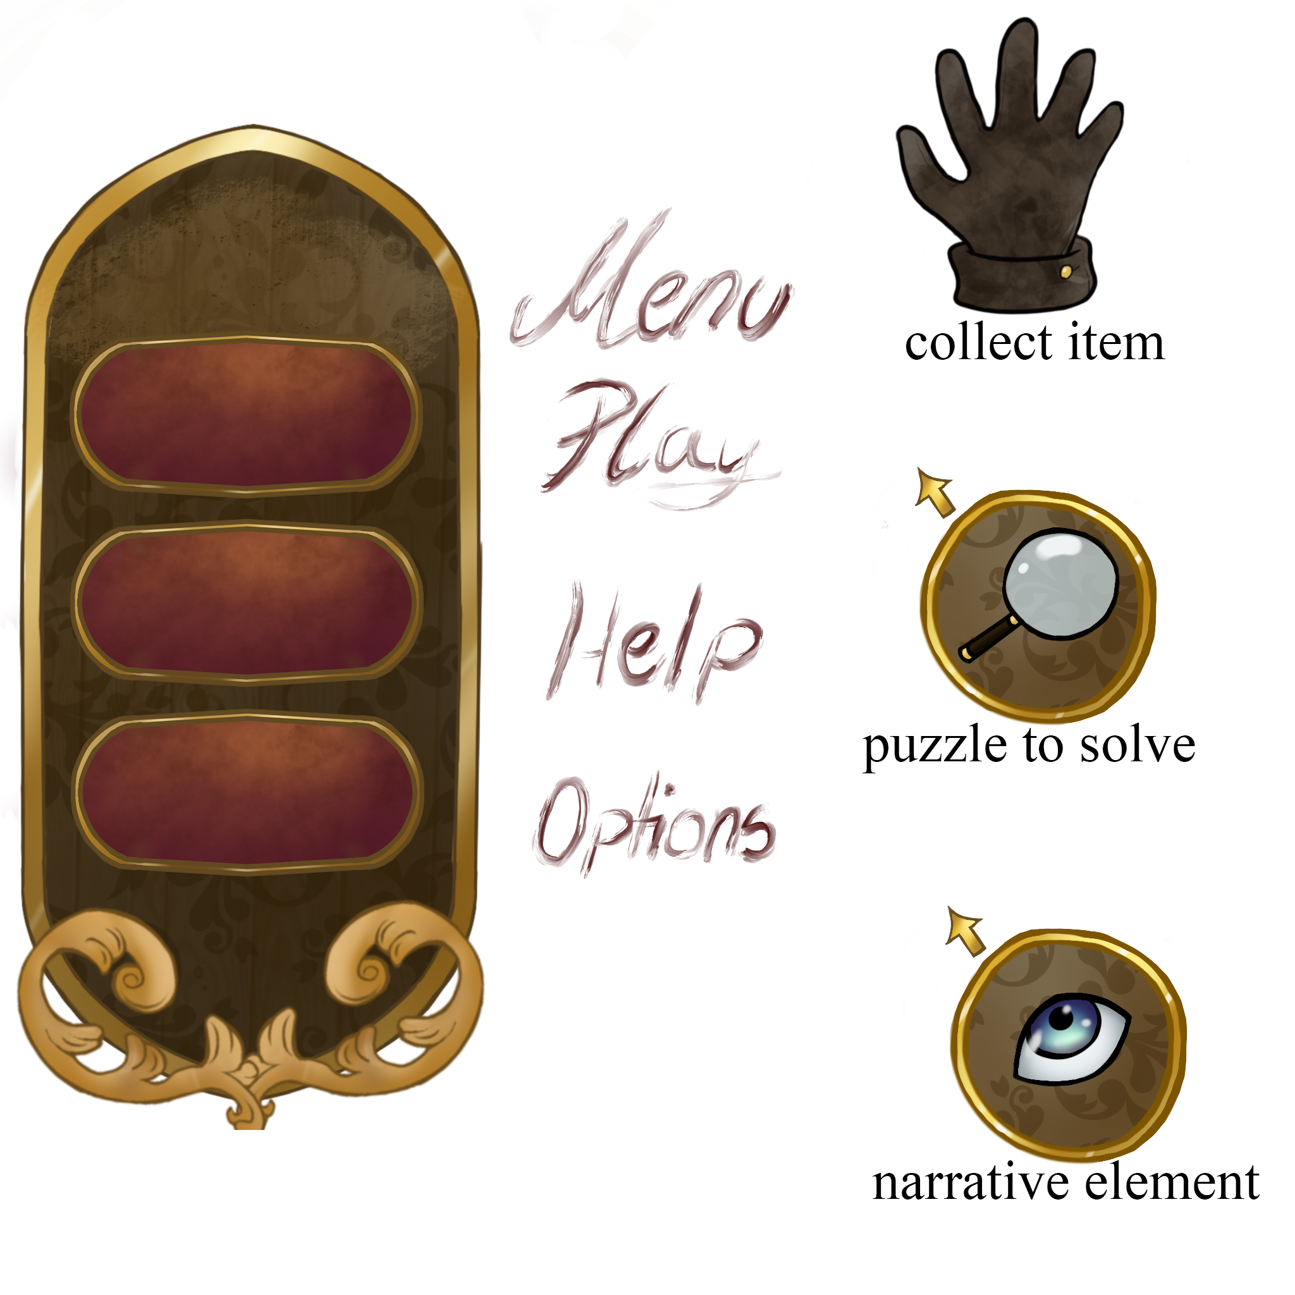
Concept 1 - Concept/Moodboards

Slide 9
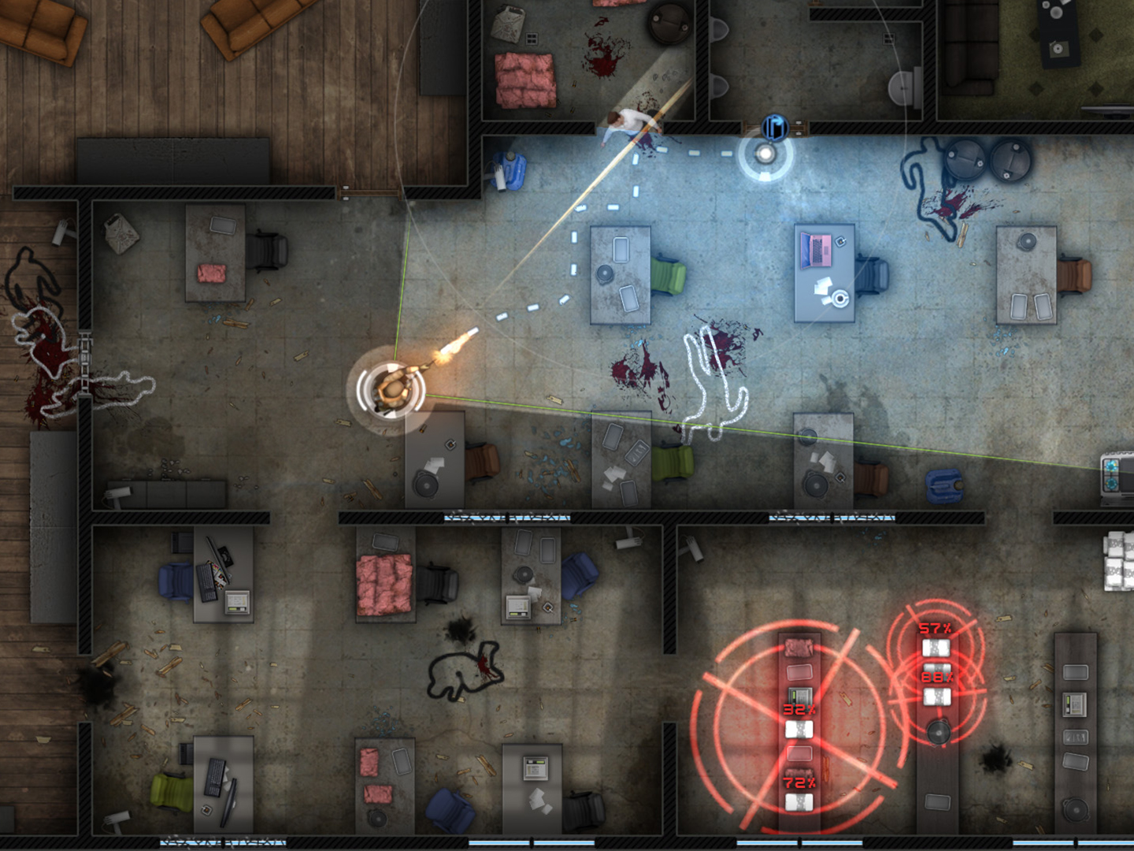
Concept 2 - Overview
Stealth Action Game
Use tools and techniques to navigate to the end of the level.
Responsive AI
Android & iOS
Top down 2D
Image reference
KillHouse Games. 2017. Door Kickers – KillHouse Games. [ONLINE] Available at: http://inthekillhouse.com/doorkickers/. [Accessed 11 October 2017].

Slide 10
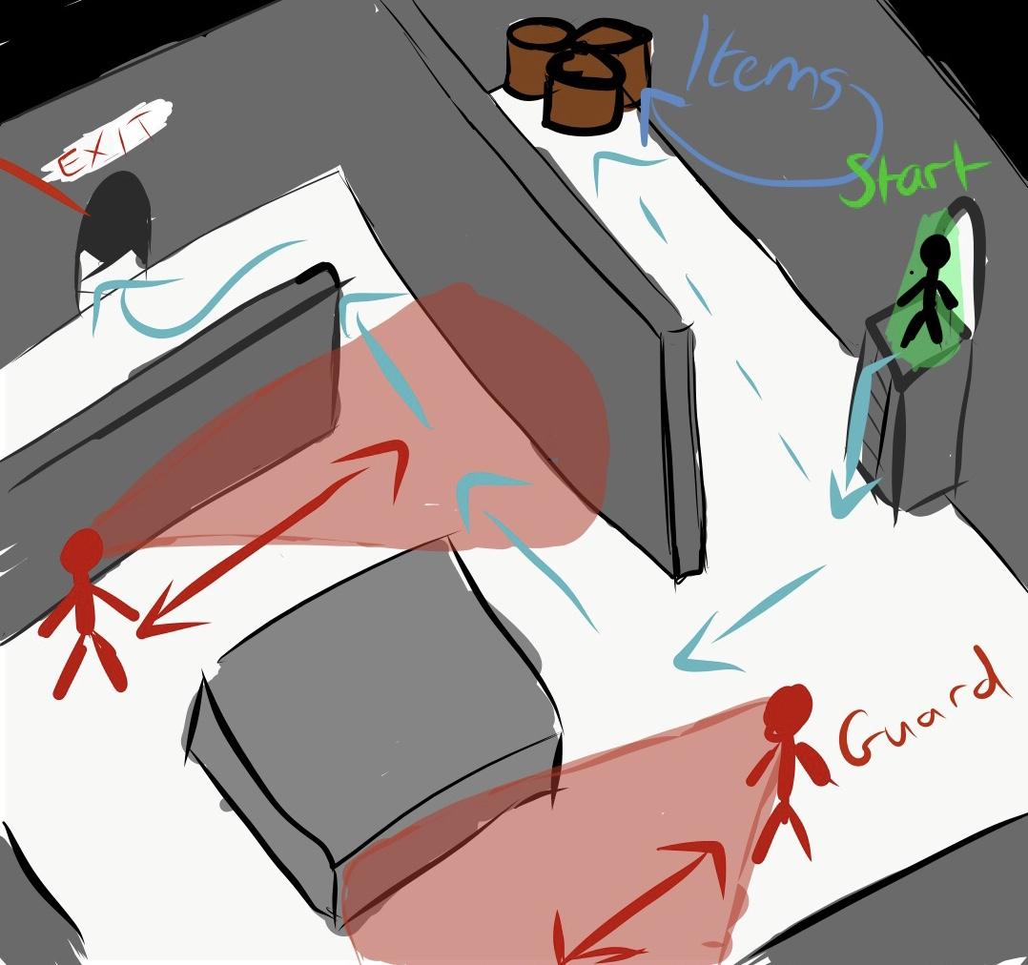
Concept 2 - Core game loop
Core game loop
Scout the level.
Plan your route.
Execute the plan.
Pause and iterate the plan in real time.

Slide 11
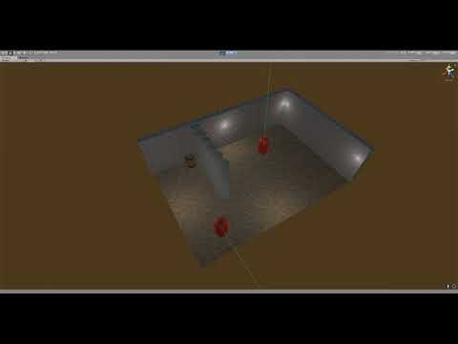
Concept 2 - Prototype

Slide 12

Concept 2 - Concept/Moodboards

Slide 13
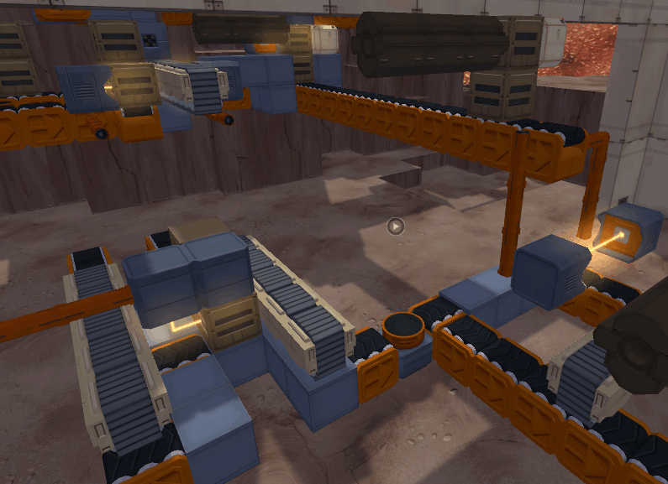
Concept 3 - Overview
Batch processing game
Using modular tools the Player is tasked with creating an output.
iOS, Android
Top Down 2D or Isometric 3D
Image reference
Infinifactory [Image] Available at: https://forums.factorio.com/viewtopic.php?f=27&t=6091&start=20 [Accessed 09 October 2017]

Slide 14
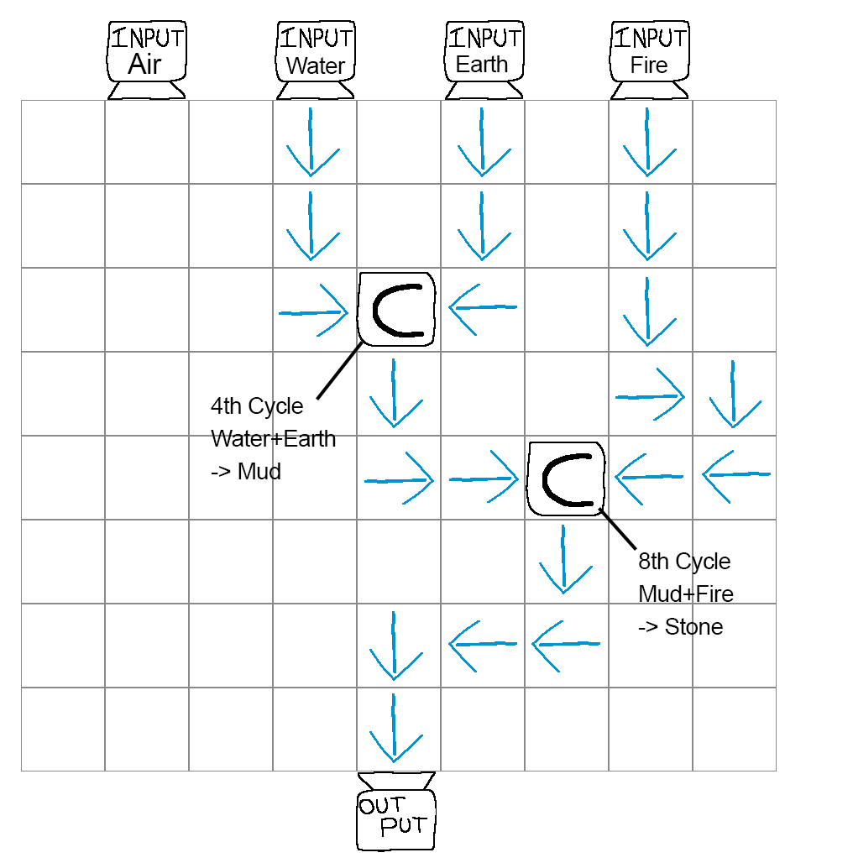
Concept 3 - Core game loop
Core game loop
Receive input.
Place modular tools to create the desired output.
Optimisation/Improvement.

Slide 15
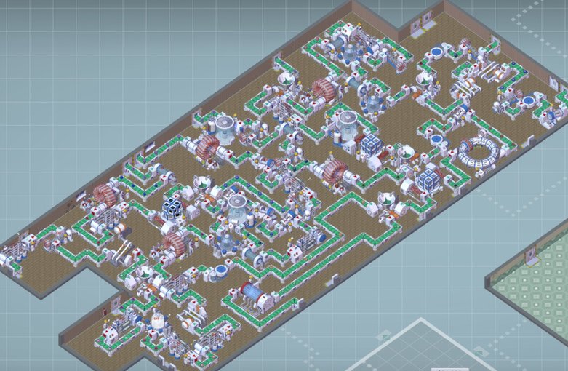
Concept 3 - Game Challenges
Game Challenges:
Space
Resource cost
Cycle efficiency / run-time
Image reference
BigPharma [Image] Available at: https://steamcommunity.com/app/344850 [Accessed 09 October 2016]

Slide 16
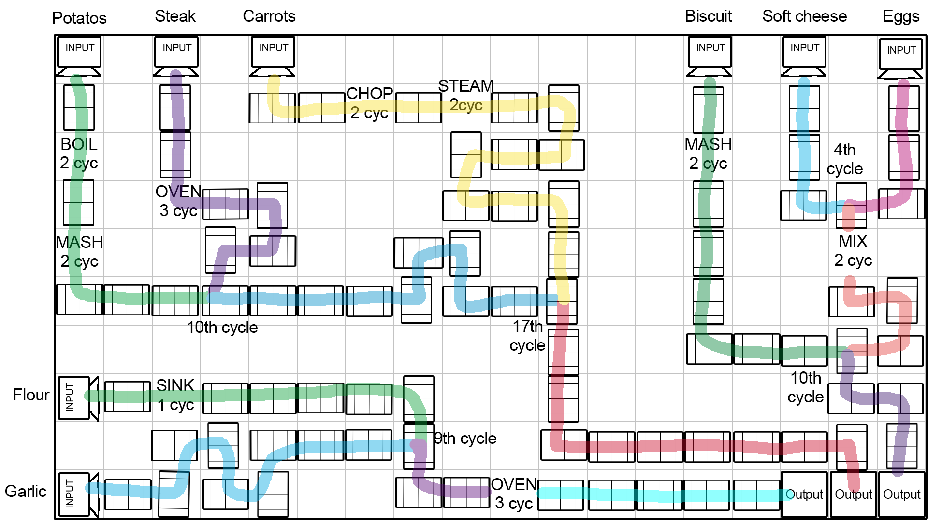
Concept 3 - Alternative Theme Example

Slide 17
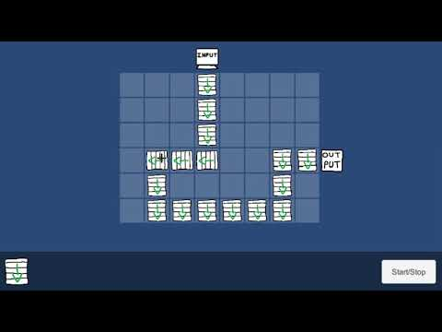
Concept 3 - Prototype

Slide 18
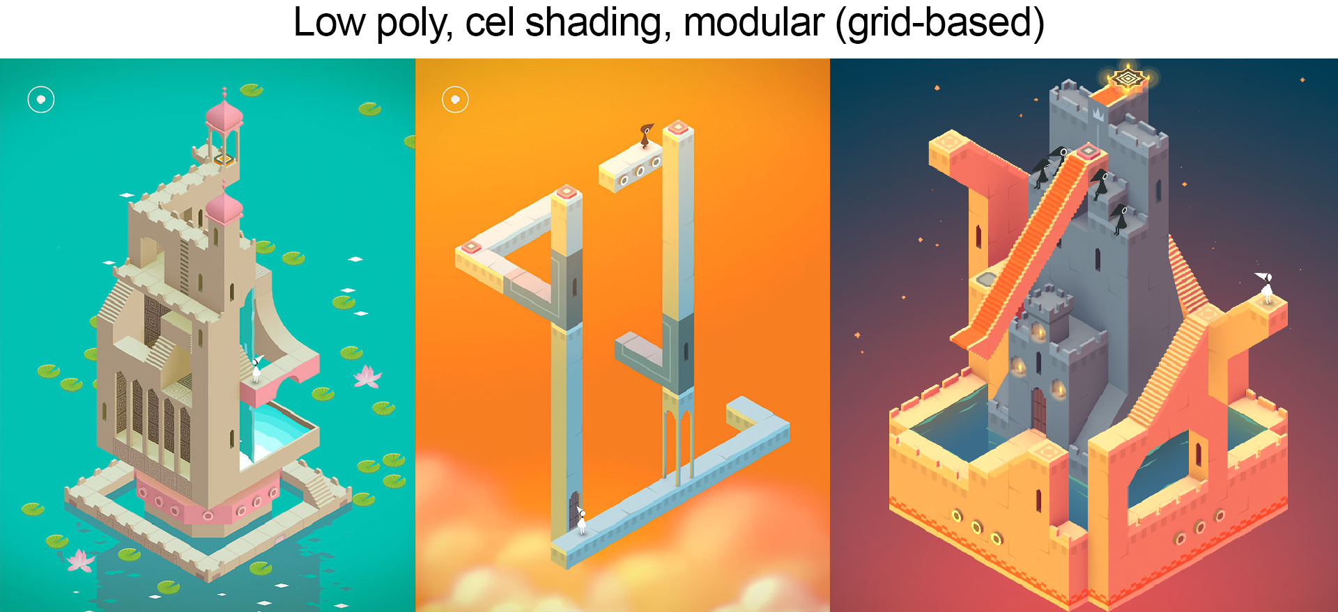
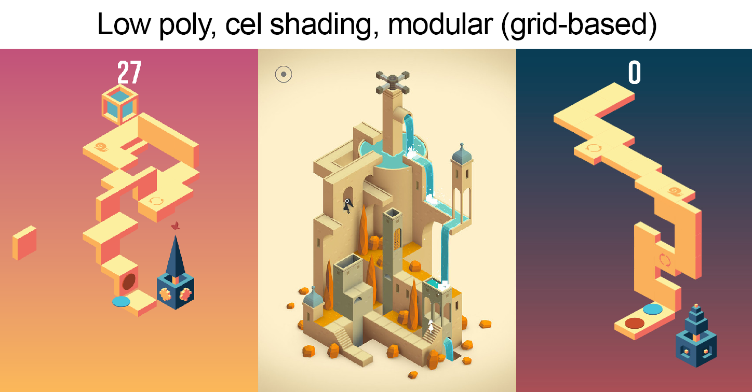
Concept 3 -Moodboards

Slide 19
Bibliography
Areliusarson, A. (2013) Designing Computer-Games Preemptively for Emotions and Player Types. [Blogpost] (19 June 2013) Available Online: http://www.gamasutra.com/blogs/AreliusAreliusarson/20130619/194574/Designing_ComputerGames_Preemptively_for_Emotions_and_Player_Types.php [Date of access: 04 July 2017]
Short, E. (2008) Emergent Puzzle Solutions [Blogpost] (13 February 2008) Available online: https://emshort.blog/2008/02/13/emergent-puzzle-solutions/ [Date of access: 08 October 2017]
Brown, M. (2015) Puzzle Solving… or Problem Solving? | Game Maker’s Toolkit. [Video] (18 June 2015) Available online: https://www.youtube.com/watch?v=w1_zmx-wU0U [Date of access: 20 June 2017]
Henrik, A. (2012) Art and Theme in a Logic puzzle game [Blogpost] (12 May 2012) Available Online: http://www.thevoxelagents.com/2012/05/art-and-theme-in-a-logical-puzzle-game/ [Date of access: 10 October 2017]
Hwong, C. (2016) The most popular mobile game genres: Who plays what, when? [Blogpost] (14 December 2016). Available online: http://www.vertoanalytics.com/the-most-popular-mobile-game-genres-who-plays-what-when/ [Date of access: 10 October 2017]
Researched games:
Poly Bridge: http://polybridge.drycactus.com/ The Witness: http://the-witness.net/ Infinifactory: http://www.zachtronics.com/infinifactory/ SpaceChem: http://www.zachtronics.com/spacechem/ Slime Rancher: http://slimerancher.com Township: https://www.playrix.com/township/
Big Pharma: http://www.bigpharmagame.com/ Minecraft: https://minecraft.net/en-us/ Brain dots: https://www.facebook.com/braindotsapp Portal: http://www.thinkwithportals.com/blog.php Door Kickers: http://www.inthekillhouse.com/doorkickers/

Slide 20
Q & A

Slide 21
Thank you for listening

